Slide 1
Estimating Undetected Income
Stanford RegLab: Patrick Vossler, Aviv Caspi, Jon Hennessy, Jacob Goldin, Dan Ho
IRS: John Guyton, Andrew Johns, Dan Rosenbaum
JSM, August 2024
The findings, interpretations, and conclusions expressed in this presentation are entirely those of the authors and do not necessarily reflect the views or the official positions of the U.S. Department of the Treasury or the Internal Revenue Service. All results have been reviewed to ensure that no confidential information is disclosed.

Slide 2
Motivation
General setting: Examiners/auditors carry out examinations/audits to
Provide approval/assess penalties
Assess overall quality or compliance
Context: Food safety (Wang et al, 2022), mining (Gernand, 2014), patents (Lemley and Sampat, 2012), OSHA (Johnson et al, 2023), IRS (Feinstein, 1991)
In many cases, these examinations provide the best/only measure of ground truth of an underlying metric
However, there can be significant variation in examiner skill which can bias aggregate estimates. How should we adjust for this?

Slide 3
IRS Setting: Undetected income
Goal: Estimate amount of taxes owed but unpaid (the “tax gap”*)
Approach:
Can’t audit all returns, so examiners audit a random sample (i.e., National Research Program)
Scale up adjustments to estimate overall tax gap
Problem:
Examiners do not find all the unpaid taxes (i.e., undetected income)
Additionally, examiners may differ in average adjustments when auditing similar sets of returns
Note: IRS tax gap estimates do address this problem!
*Research, Applied Analytics & Statistics. 2022. “Federal Tax Compliance Research: Tax Gap Estimates (2014–2016).” Internal Revenue Service. https://www.irs.gov/pub/irs-pdf/p1415.pdf.

Slide 4
Statistical Approaches for Imperfect Detection
Detection Controlled Estimation (DCE)
  Currently used to estimate tax gap
  Feinstein, 1991; Erard and Feinstein, 2010
  Models latent non-compliance and detection using multiple equations
  Assumptions around detection rates enable identification
  Fit by directly maximizing likelihood
Relative Rate Model
  Alternative approach with following goals
    Interpretable and makes clear assumptions
    Easy to fit (ideally, off the shelf)
    Fits naturally in Bayesian framework
    Works in IRS setting and more generally

Slide 5
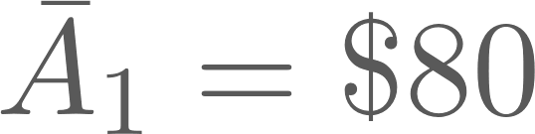
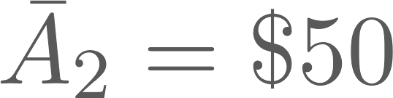
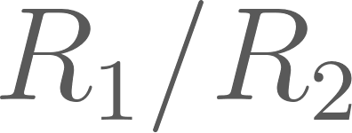
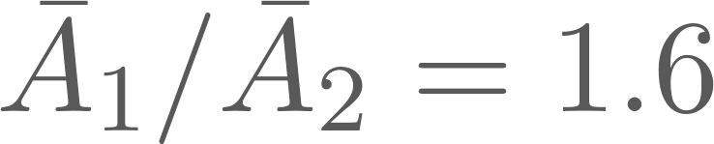
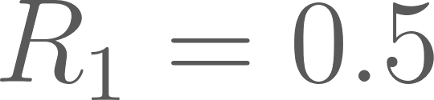
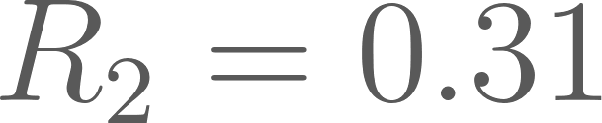
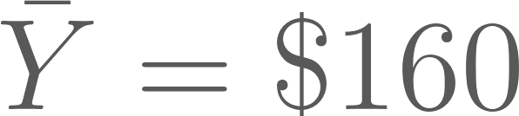
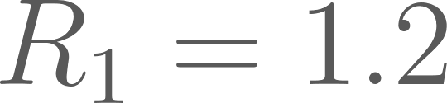
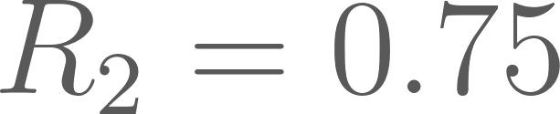
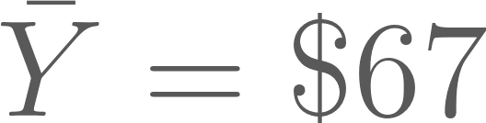
Fundamental problem
A little notation…
Y = true misreporting
R = detection rate
A = R * Y (adjustment)
Say examiners are randomly assigned cases
Examiner 1: 25 cases,
Examiner 2: 30 cases,
We can estimate relative detection rates (ratio of rates)
Estimate with
But absolute detection rates are not identified (no ground truth!)
, and ?
Or , , and ?
Both are consistent with observed data.

Slide 6
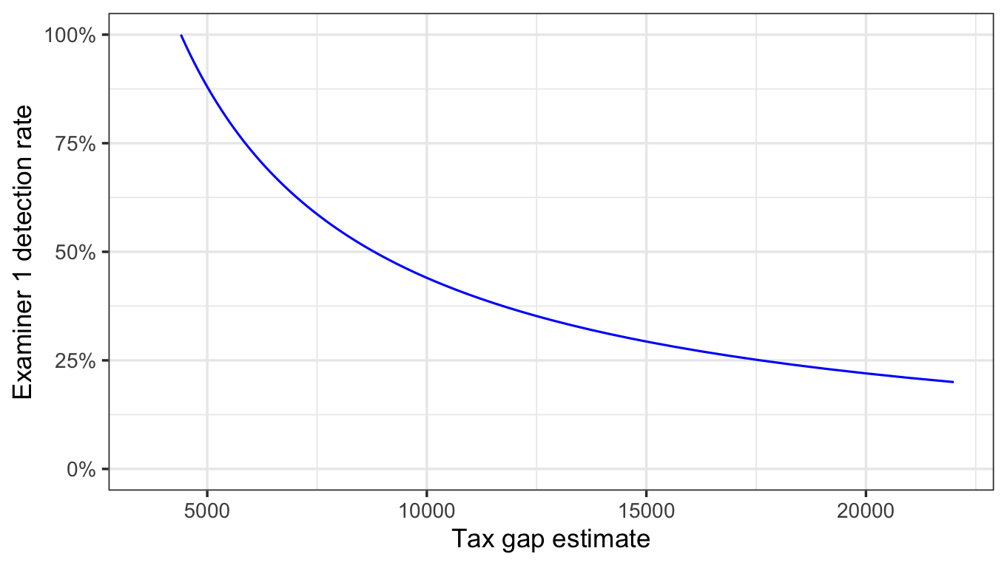
Detection-Tax Gap Frontier
Maps relationship between detection rates and tax gap estimate
Examiner/adjustment data informs the shape/position but to know where are are on the frontier, need
More data
Or, more assumptions
Notes:
R code
—------
library(tidyverse)
n_1 = 25
A_1 = 80
n_2 = 30
A_2 = 50
gamma_1 = c(1, seq(0.2, 1.2, length.out = 100))
gamma_2 = gamma_1 * A_2 / A_1
tax_gap = n_1 * A_1 / gamma_1 + n_2 * A_2 / gamma_2
df = tibble(gamma_1 = gamma_1,
tax_gap = tax_gap)
df %>%
ggplot(aes(x = tax_gap, y = gamma_1)) +
geom_line(color = "blue") +
geom_hline(yintercept = 1, linetype = "dotted") +
geom_vline(xintercept = df %>% filter(gamma_1 == 1) %>% pull(tax_gap),
linetype = "dotted") +
ylim(0, NA) +
labs(x = "Tax gap estimate",
y = "Examiner 1 detection rate") +
theme_bw(12)

Slide 7
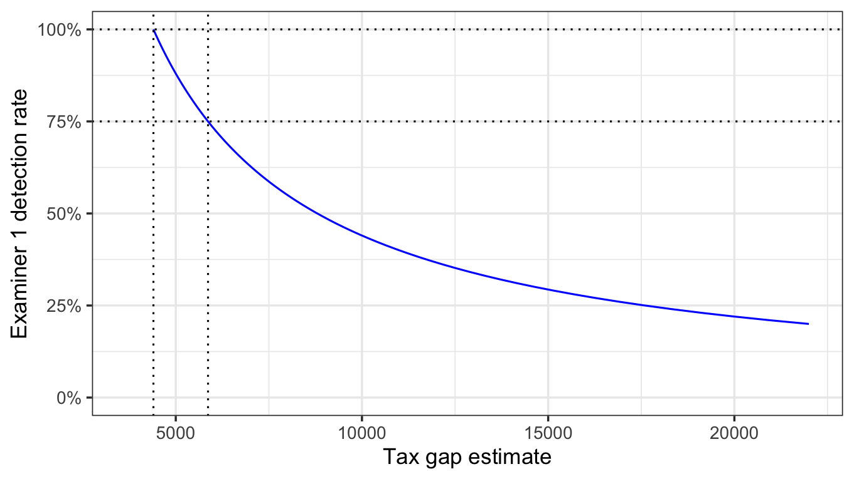
Detection-Tax Gap Frontier
Let examiner 1’s detection rate = 100%
Example assumptions:
Assume examiner 1’s detection rate is 75%, tax gap est. = $5,867
Assume examiner 1’s detection rate is 100%, tax gap est. = $4,400
Let examiner 1’s detection rate = 75%
Notes:
R code
—------
library(tidyverse)
n_1 = 25
A_1 = 80
n_2 = 30
A_2 = 50
gamma_1 = c(1, seq(0.2, 1.2, length.out = 100))
gamma_2 = gamma_1 * A_2 / A_1
tax_gap = n_1 * A_1 / gamma_1 + n_2 * A_2 / gamma_2
df = tibble(gamma_1 = gamma_1,
tax_gap = tax_gap)
df %>%
ggplot(aes(x = tax_gap, y = gamma_1)) +
geom_line(color = "blue") +
geom_hline(yintercept = 1, linetype = "dotted") +
geom_vline(xintercept = df %>% filter(gamma_1 == 1) %>% pull(tax_gap),
linetype = "dotted") +
ylim(0, NA) +
labs(x = "Tax gap estimate",
y = "Examiner 1 detection rate") +
theme_bw(12)

Slide 8
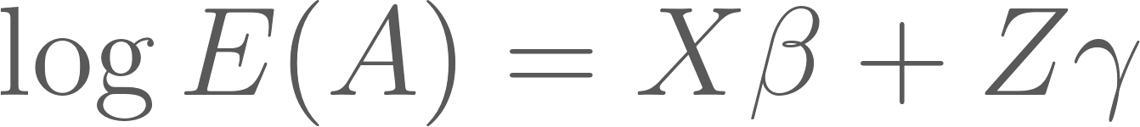
Relative Rate Model
Model return-level adjustment as a function of covariates and examiner skill as a GLM where
Here, X represents the covariates and Z a matrix of dummy variables for the examiners
  We use a contrast coding for Z so that the detection rates are relative to the average rate
Detection rates are still multiplicative (note the log)
Assume A ~ Tweedie to account for point mass at 0 but positive and continuous otherwise
  Can use other distributions or even model 0 and continuous adjustments separately

Slide 9
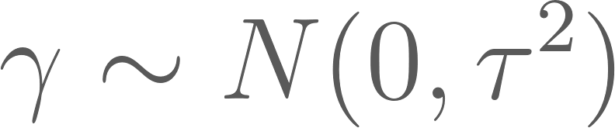
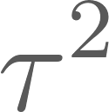
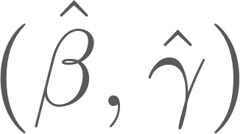
Hierarchical Prior for Examiner Skill
Include a prior on examiner effect coefficients to shrink examiners with small number of exams
Estimate using Empirical Bayes and approximate EM algorithm
Approximate likelihood around MLE with Normal

Slide 10

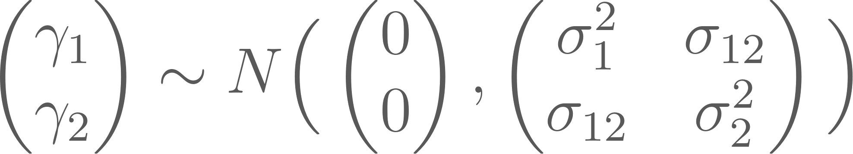
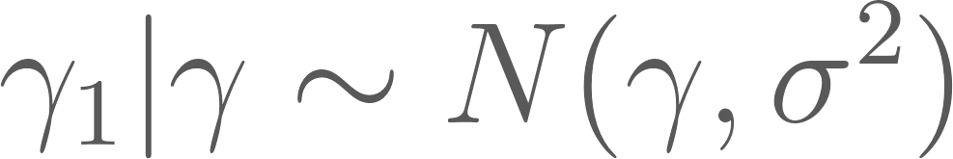
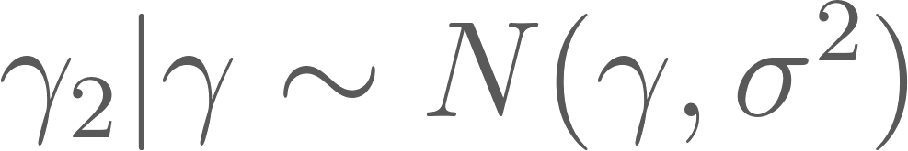
Hierarchical Prior for Multiple Return Types
Additionally, can use prior to pool information/borrow strength across return types (and/or over time). Examiner gets a different for each return type.
Again, choose prior hyperparameters using Empirical Bayes and approximate EM
Option 1
Option 2

Slide 11
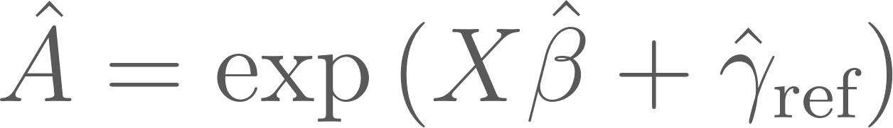
Tax Gap Estimates
To generate a tax gap, we have to choose a reference examiner, who we say has a detection rate of 100%. Some options…
Examiner with max estimated relative rate
Percentile examiner
  If max relative rate is too noisy
Synthetic/composite examiner – average of top examiners
Ideally, decision should be informed by experience with examiners and audit process
Then, predict adjustment as if the reference examiner were auditing all returns,

Slide 12
Model Summary
Approach
Modeling adjustment, rather than underlying misreporting
Estimate relative detection rates and then make explicit assumption about reference examiners
  Ideally, informed by subject-matter experience
Predict misreporting based on what reference examiner would find as adjustment
  Generate interval via posterior sampling, link
Assumptions
Top examiners detect misreporting accurately and we can identify them
Distribution and functional form of GLM are correct
  Adjustment follows Tweedie-like shape
Returns are assigned randomly or at least on observed covariates

Slide 13
Simulation

Slide 14
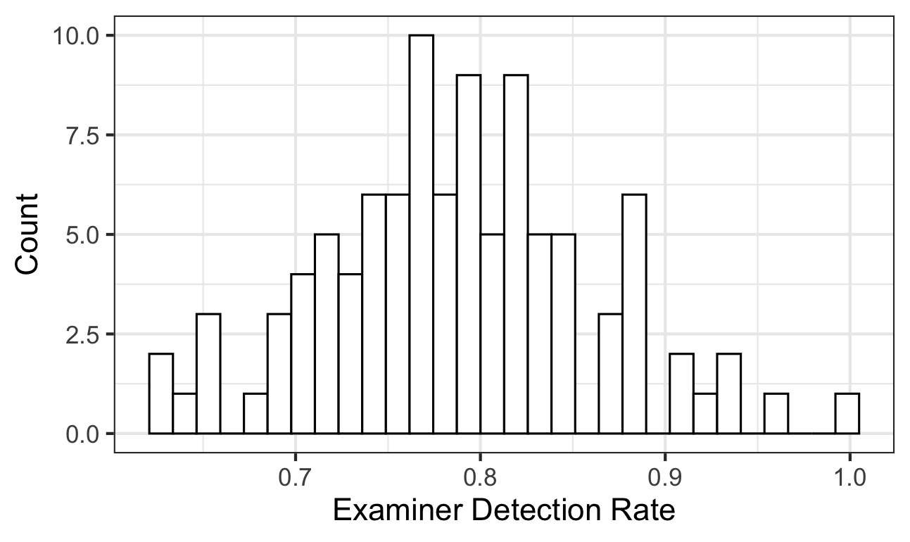
Generate Examiner Skill Distribution
# of examiners: 100
Detection rates drawn from Log-Normal(0, 0.1), where max rate set to 1.0

Slide 15
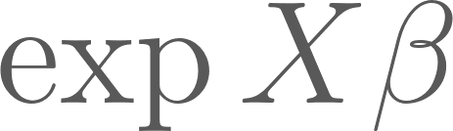
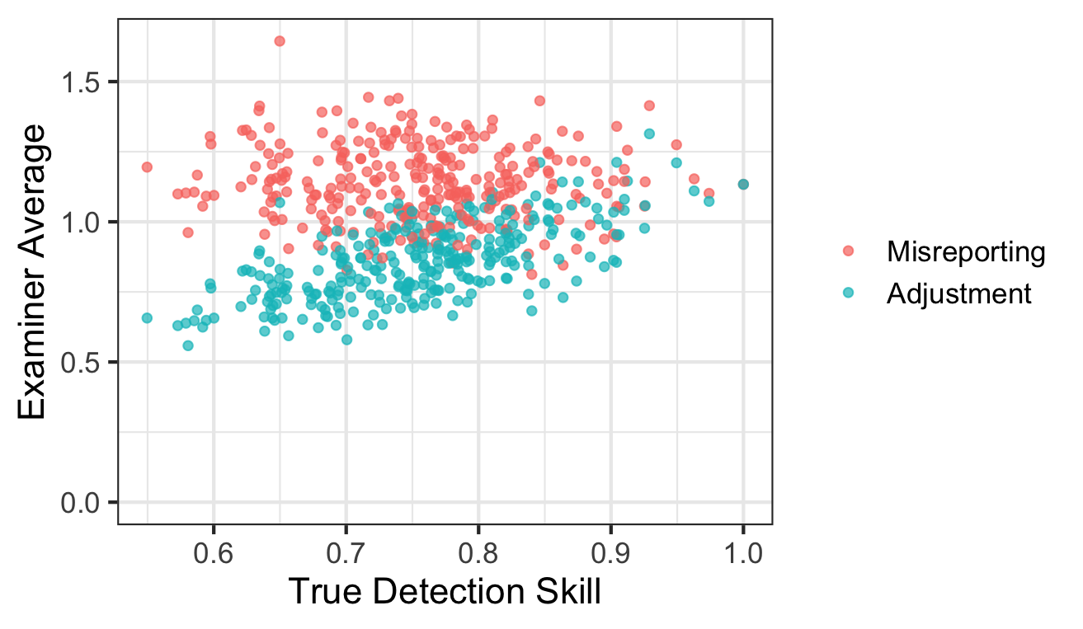
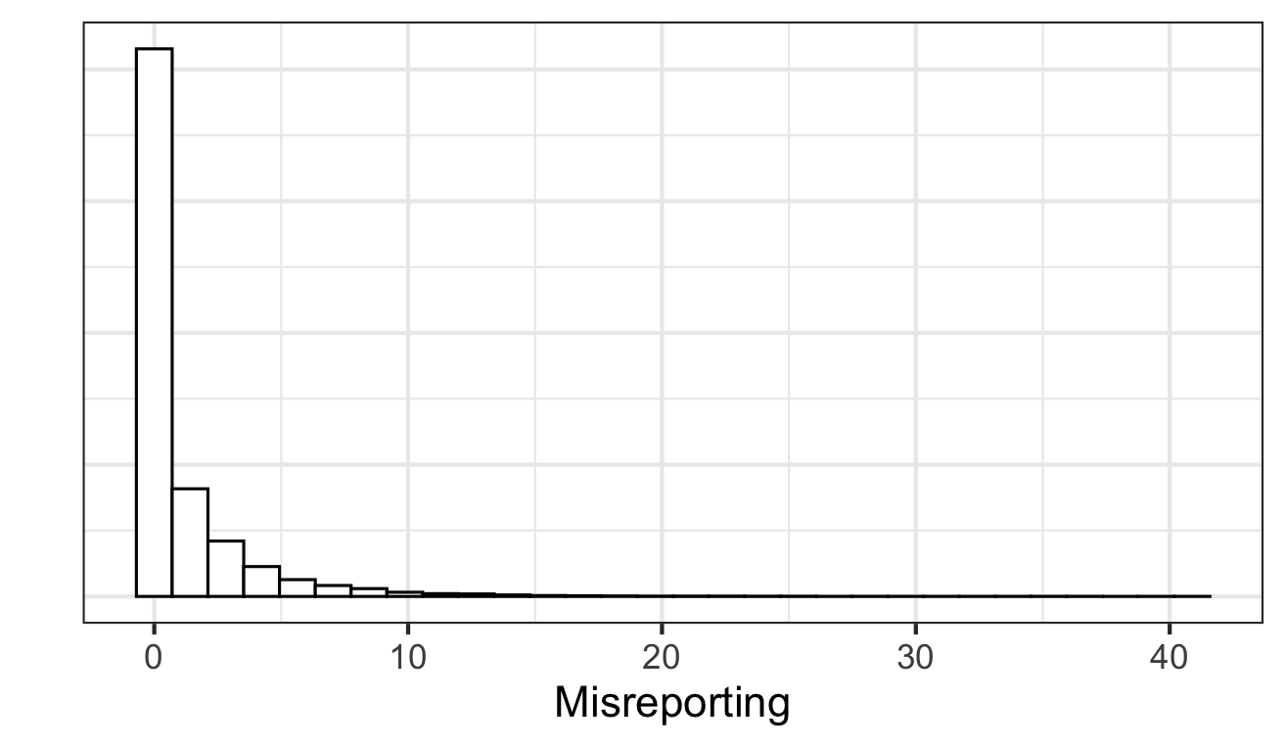
Simulate true misreporting and observed adjustment
Misreporting ~ Tweedie( , power = 1.65, phi = 4)
  Point mass at zero with a long tail
Adjustment = max(misreporting * detection + noise, 0)
~50% of misreporting = 0

Slide 16
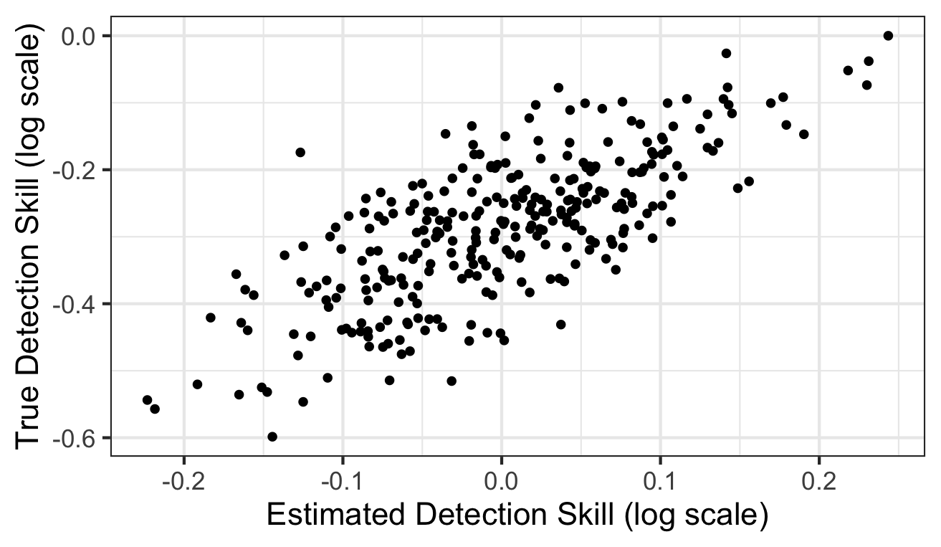
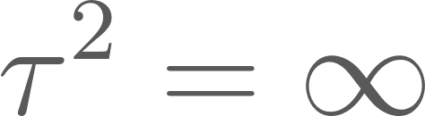
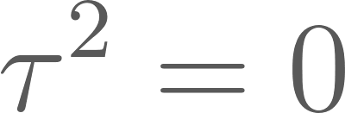
Relative rates estimates are correlated with true rates
Predict tax gap based on what top examiner would detect
Compare tax gap estimates with truth
SRR – RR model with shrinkage (using max est. examiner)
RR – RR model w/out shrinkage (max est. examiner),
Average of adjustments – treat
all examiners as perfect,

Slide 17
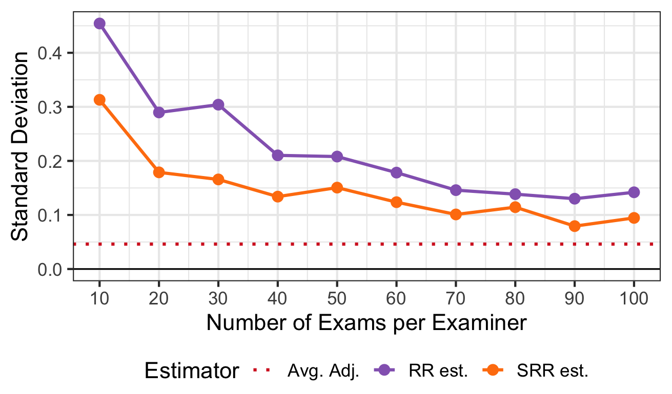
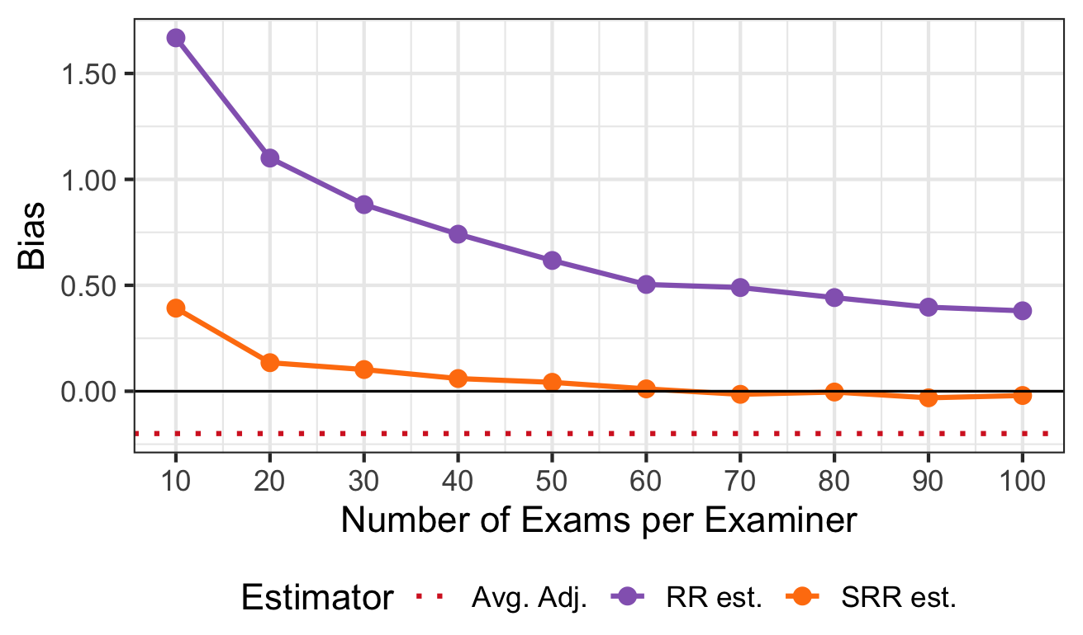
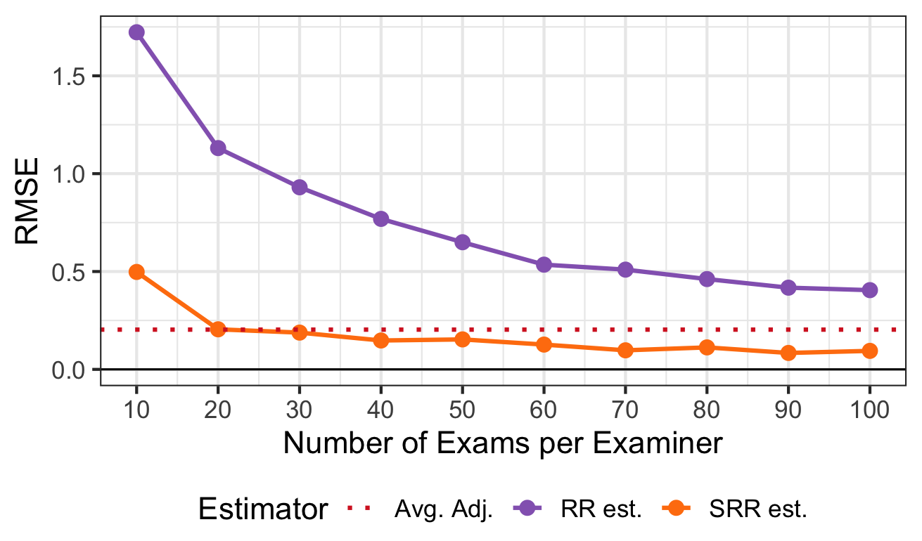
Shrinkage estimator unbiased at 60 exams/examiner

Slide 18
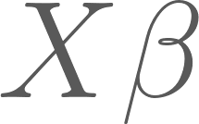
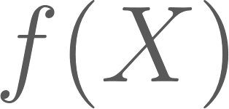
Learnings and next steps…
Compare to current IRS methods for adjusting for incomplete detection (Feinstein, 1991; Erard and Feinstein, 2010)
Further develop methodology for pooling across return types and time
Explore replacing with more flexible ML model

Slide 19
Thanks!

Slide 20
References
Erard, B., B. Erard, Associates., and Jonathan Feinstein. 2011. “The Individual Income Reporting Gap: What We See and What We Don’t.” https://www.irs.gov/pub/irs-soi/11resconindincome.pdf.
Feinstein, Jonathan S. 1991. “An Econometric Analysis of Income Tax Evasion and Its Detection.” The Rand Journal of Economics 22 (1): 14.
Gernand, Jeremy M. 2014. “Machine Learning Classification Models for More Effective Mine Safety Inspections.” In Volume 14: Emerging Technologies; Engineering Management, Safety, Ethics, Society, and Education; Materials: Genetics to Structures, V014T08A020. American Society of Mechanical Engineers.
Johnson, Matthew S., David I. Levine, and Michael W. Toffel. 2023. “Improving Regulatory Effectiveness through Better Targeting: Evidence from OSHA.” American Economic Journal. Applied Economics 15 (4): 30–67.
Lemley, Mark A., and Bhaven Sampat. 2012. “EXAMINER CHARACTERISTICS AND PATENT OFFICE OUTCOMES.” The Review of Economics and Statistics 94 (3): 817–27.
Wang, Xinxin, Yamine Bouzembrak, Agjm Oude Lansink, and H. J. van der Fels-Klerx. 2022. “Application of Machine Learning to the Monitoring and Prediction of Food Safety: A Review.” Comprehensive Reviews in Food Science and Food Safety 21 (1): 416–34.
Research, Applied Analytics & Statistics. 2022. “Federal Tax Compliance Research: Tax Gap Estimates (2014–2016).” Internal Revenue Service. https://www.irs.gov/pub/irs-pdf/p1415.pdf.

Slide 21
Appendix

Slide 22
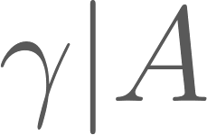
Posterior Mean and Interval for Tax Gap
We can also account for
uncertainty in estimate of
uncertainty in which examiner has the highest detection rate
Generate posterior mean and interval for tax gap by
Draw from the posterior distribution
Conditional on draw, choose reference examiner and predict adjustments
Repeat
Report mean of draws and create interval (not currently implemented in simulations)

